Slide 1
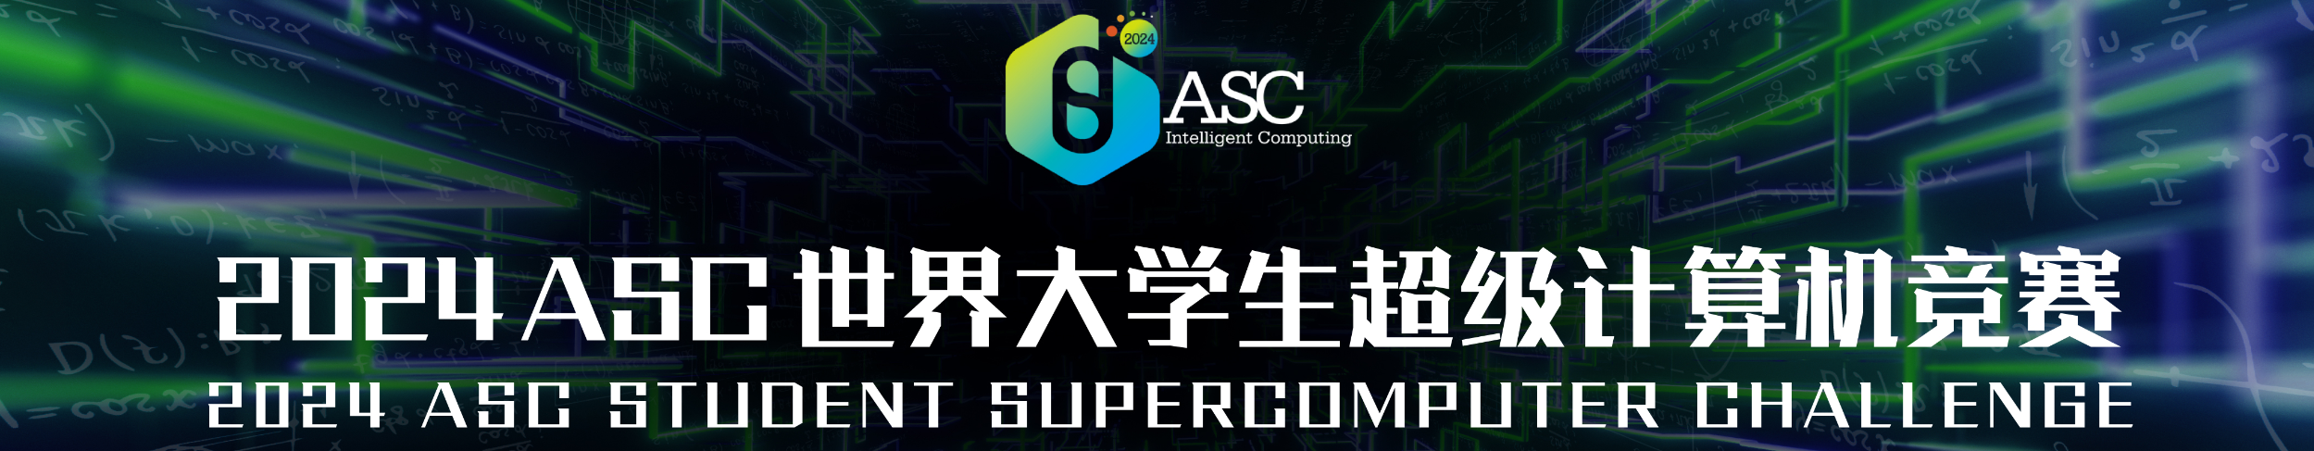



Sharing Insights: My Experience and Learnings from the HPC Competition
Xu Yi
2024.1.4 Beijing
Notes:
Hello, I’m Yi Xu, the captain of the team, and first I'd like to express my gratitute our team members, our advisors and committee members who did a lot for the competition.

Slide 2

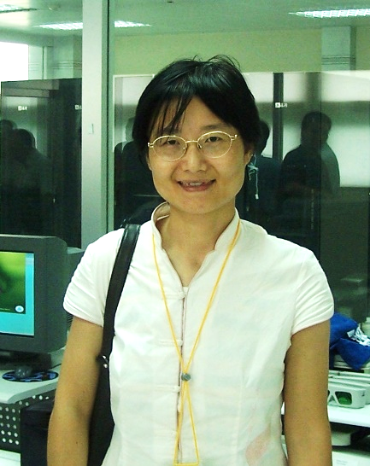
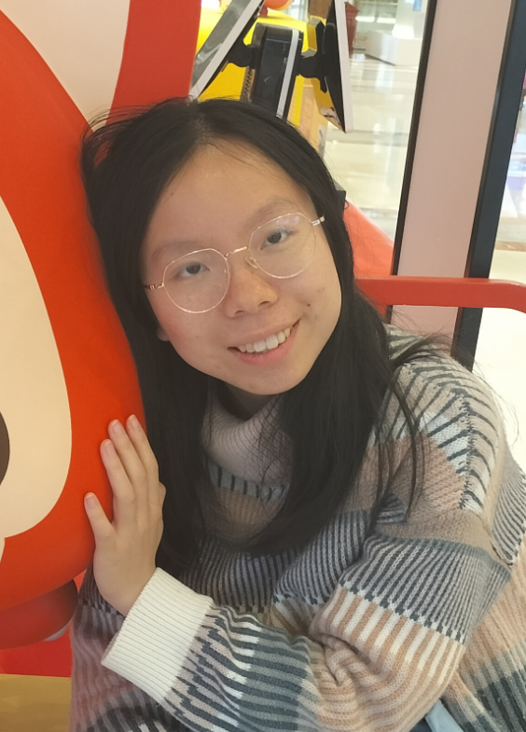
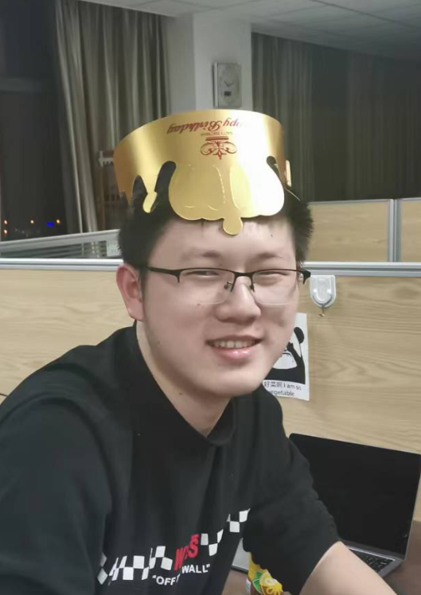
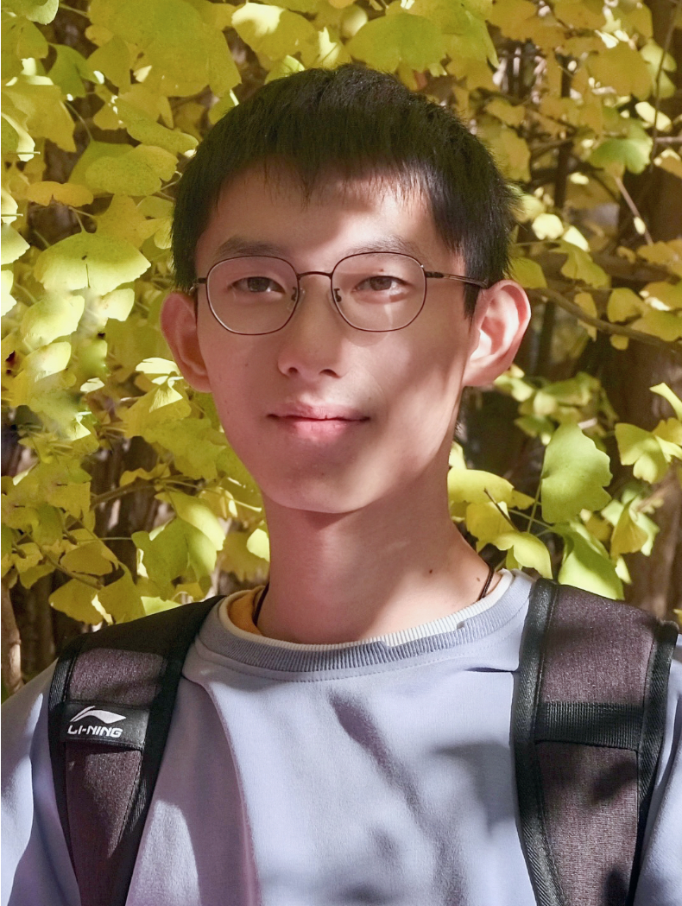
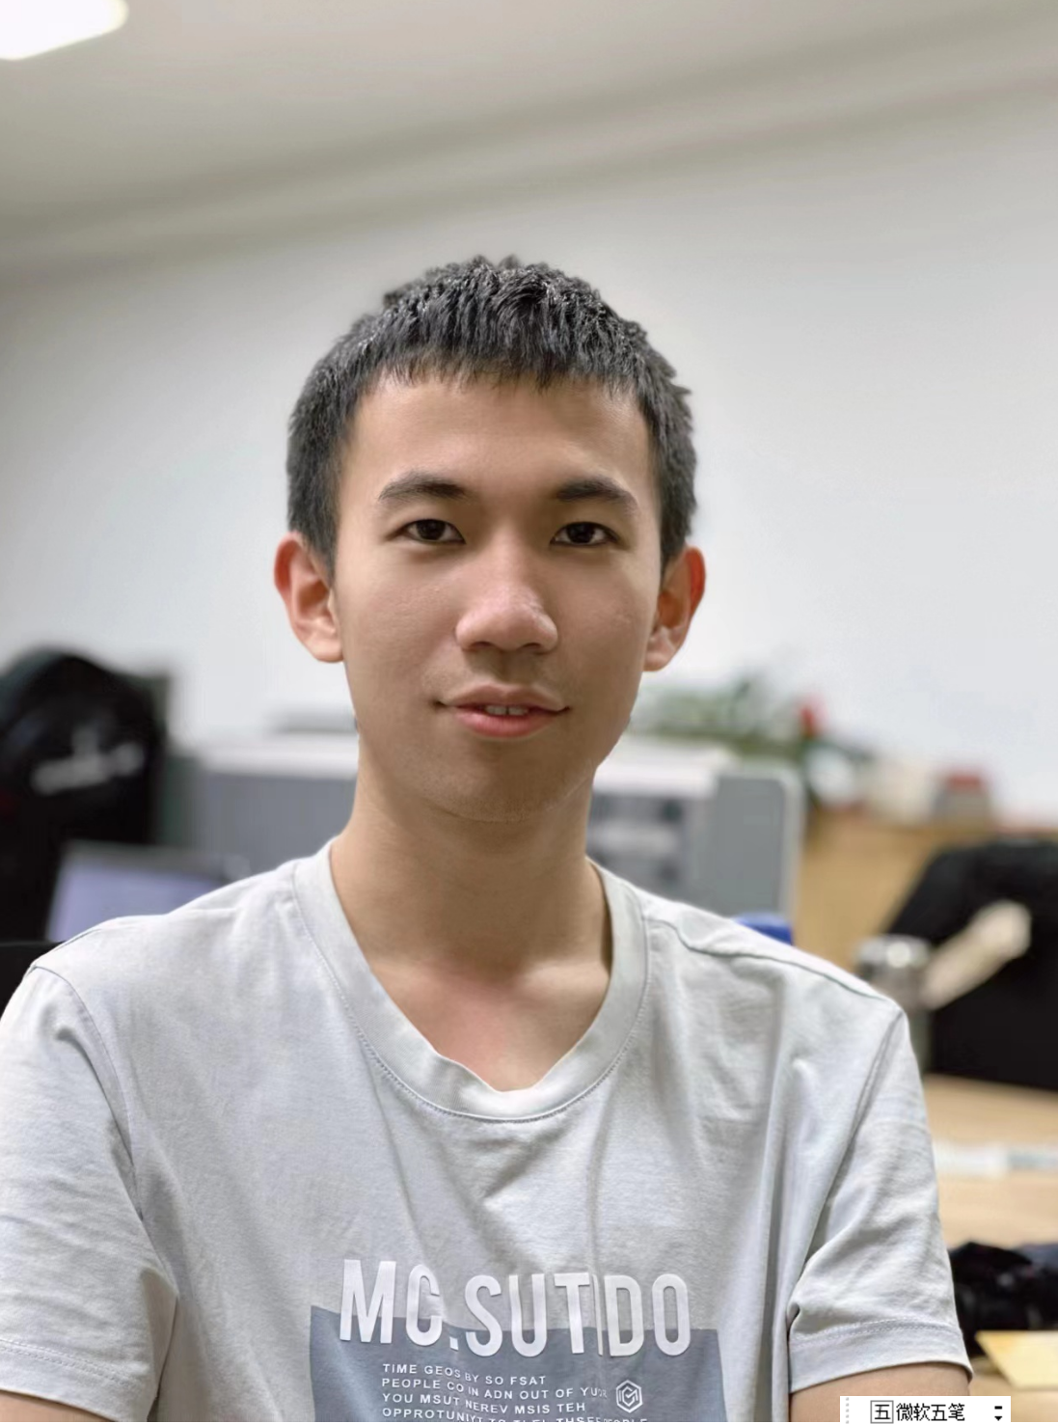
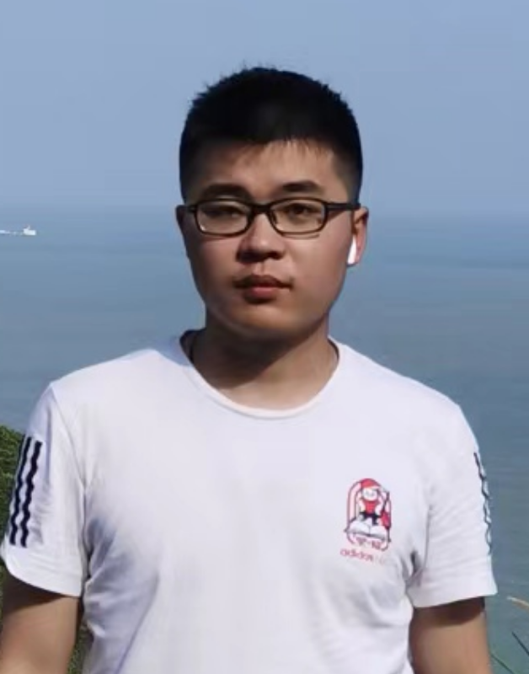

Our Team
Hong An(安虹)
Adviser
Professor, School of Computer Science and Technology
Parallel computer system architecture
Parallel programming environment and tools
High performance computing
Yi Xu(徐怡)
Captain
Senior student, School of Computer Science and Technology
Linpack，HPCG， WRF-Hydro， Group Competition
Tianming Wu(吴天铭)
Vice Captain
Junior student, School of Gifted Young, major in Computer Science and Technology
Linpack，HPCG， YLLM，Mystery Application
Yaoqi Chen(陈耀琪)
Member
Senior student, School of Computer Science and Technology
DeePMD， WRF-Hydro ，Group Competition
Shicheng Zheng (郑师程)
Member
Senior student, School of Computer Science and Technology
YLLM， Mystery Application
Weiye Xu(徐炜烨)
Member
Senior student, School of Information Science and Technology
DeePMD, Group Competition

Slide 3
Overview
1
Personal Growth and Rewards
2
Strategies and Techniques
3
Memorable Moments

Slide 4
Personal Growth and Rewards

Slide 5
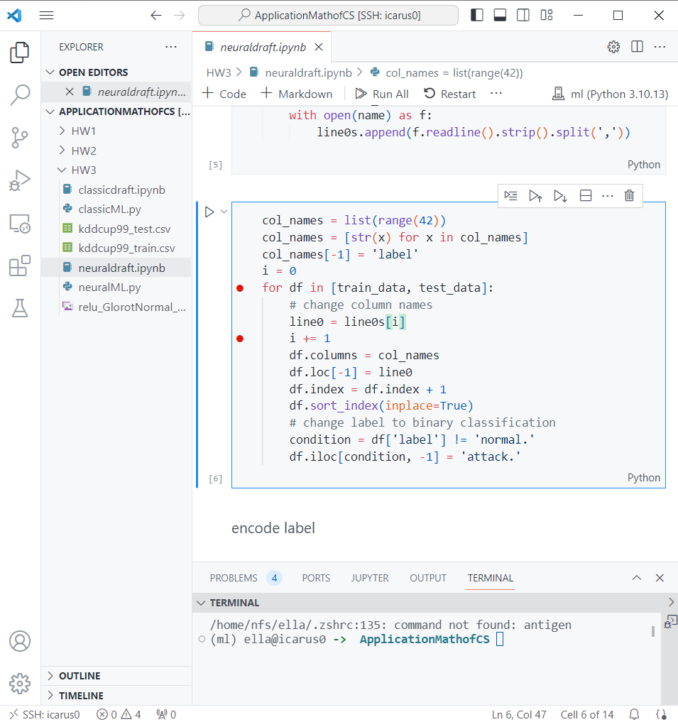

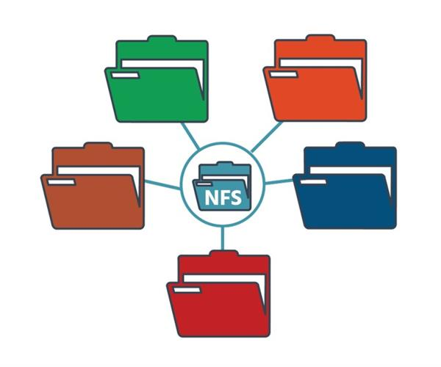


Personal Growth and Rewards
Work in Linux
Grasp basic commands
Set up development environment
Install packages
Install from package manager, from script, compile from source code, etc.
Manage packages and environment
Use conda, manage environment variables
Connect remote server
Connect in VSCode, debug in VSCode, etc.
Manage servers
Install OS
Network File System
Backup disks

Slide 6

Personal Growth and Rewards
Understand application background
Physical numerical simulation
AI for science
Language model
Get a feel of the game
Scoreboard, judging panel, interviews
Cooperate with teammates
Never feel shy to ask for help
Meet students with passion and talents
Get a sense of hardware
Memory, disk, GPU, fans, etc.
Get a sense of control
Anything can be debugged
Any ideas can be implemented by code
Any hardware options can be configured
Any questions can be searched

Slide 7
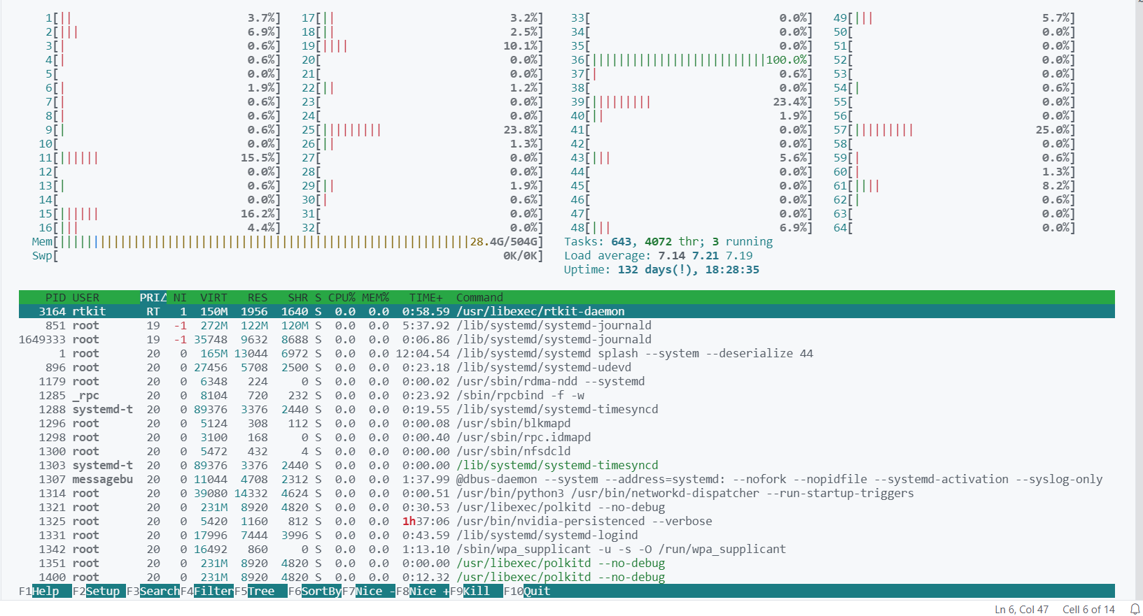
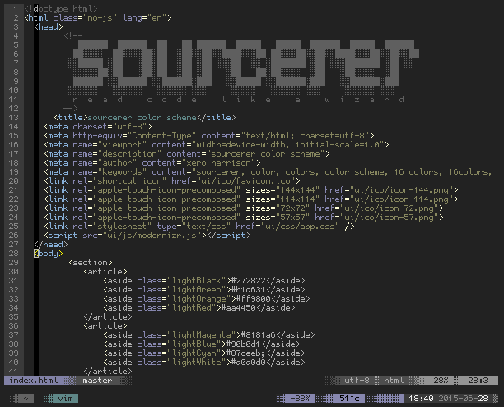
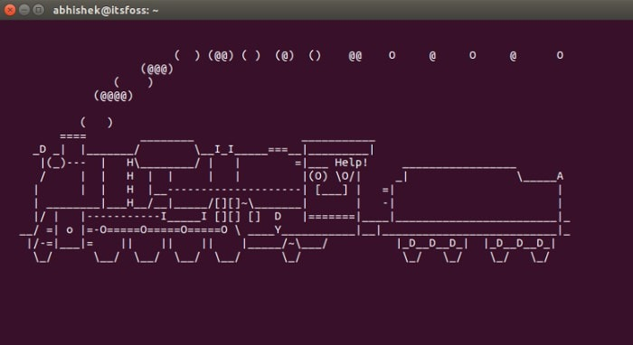

Personal Growth and Rewards
Some useful tools
Vim
Obsidian
Htop
Kill

Slide 8
Personal Growth and Rewards
Two stories
Help lab-mate to install a software package
Help roommate to fix version conflict of CUDA

Slide 9
Strategies and Techniques

Slide 10
HPL & HPCG
HPL
Solves a dense linear system in double precision arithmetic
Performs as HPC Linpack Benchmark
Checks for system failure
HPCG
Models the data access patterns of real-world applications such as sparse matrix calculations
Tests memory and communication
Optimization
Get full understand of the parameters
Search for best parameters
Single node | Result (Tflops) | Power (W)
Node0 | 28.19 | 1160
Node1 | 23.21 | 1192
Node2 | 28.01 | 1202
Node3 | 28.12 | 1147

Slide 11
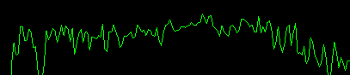
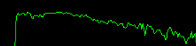
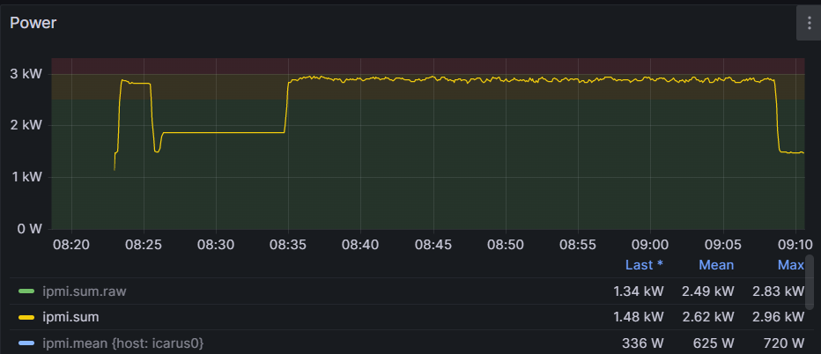
Power Control
BIOS
Change CPU power state
Disable hyper thread
Fan
Limit power
CPU & GPU
Limit power
Less cores
Power monitor

Slide 12
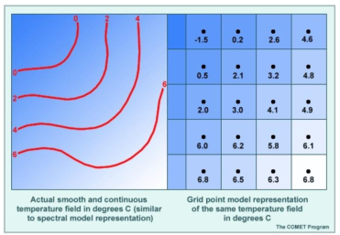
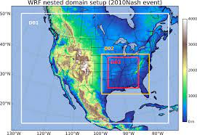
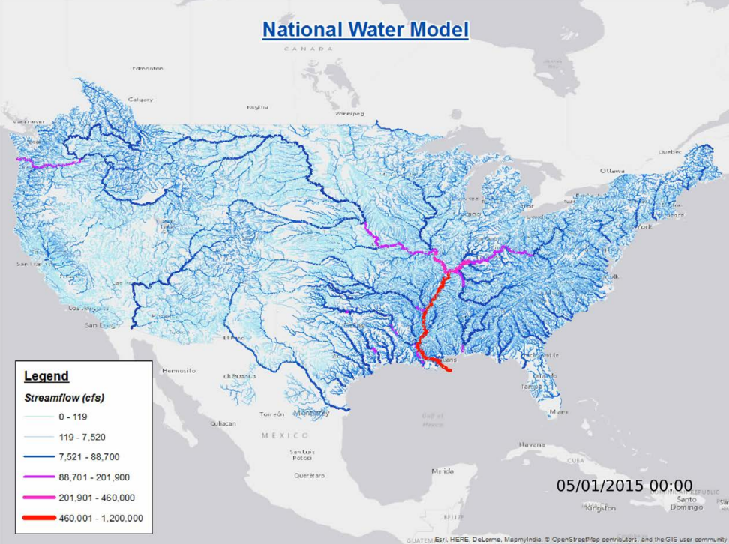
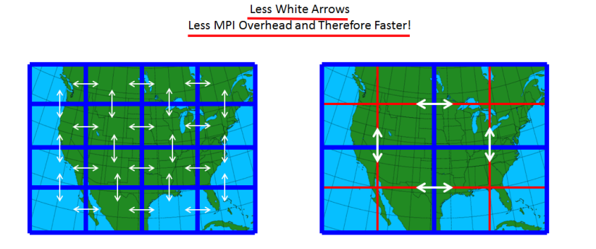
WRF-Hydro
Background
Provide a means to couple hydrological model components to atmospheric models

Slide 13
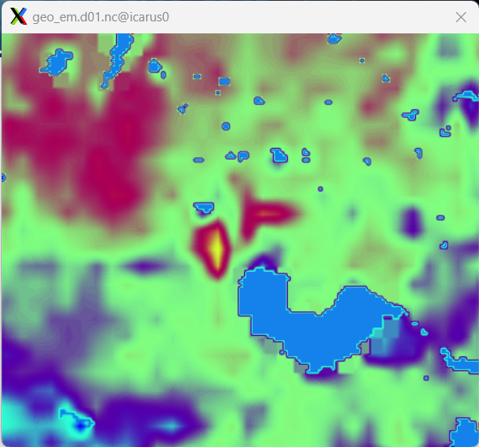
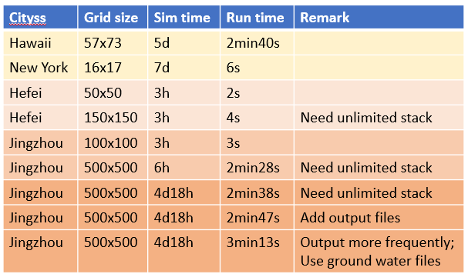
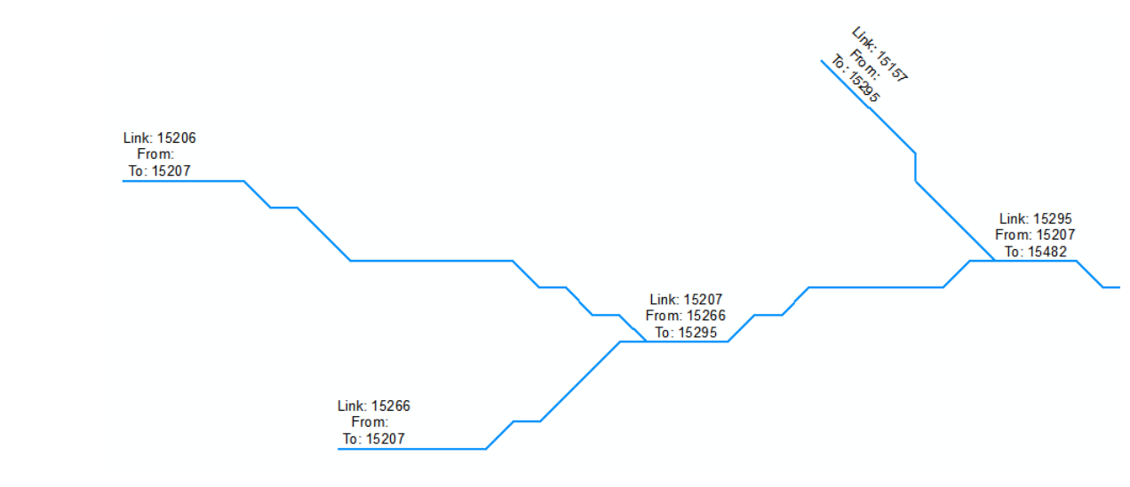
WRF-Hydro
Generate testcases
Enlarge the domain or simulation time
Select domain with more water info
Set smaller time steps
Define the domain
Define initial conditions
Hydrologic routing input
Meteorological forcing data
Run simulation

Slide 14
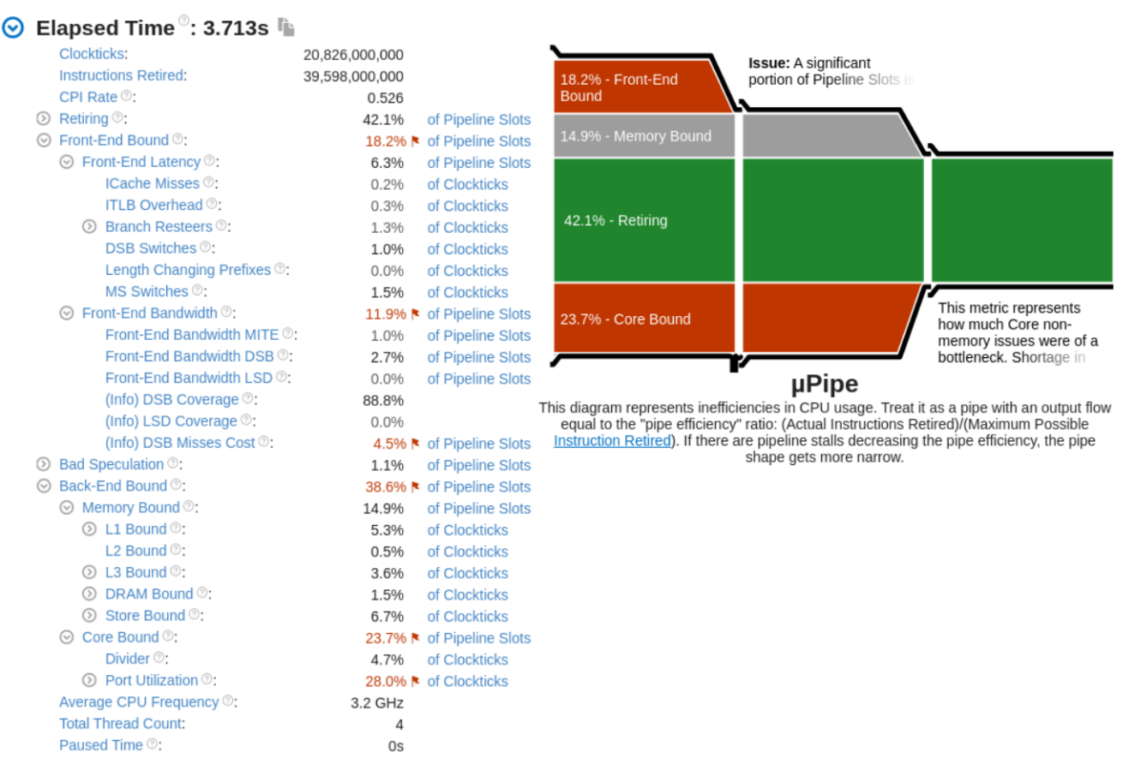
WRF-Hydro
Optimization
Profile using VTune
Front-end bound: branch, pre-fetch,…
Back-end bound: FP ops, data-dependency,…
Compiler flags: function inline, vectorization
Multi processes, OMP threads
Time(s)
CF:
Less precise
Legend:
CF – compiler flags;
nproc – num of processes
CF:
Vectorization
nproc4
 | Elapsed time | Back-end bound
Before optimization | 3.713s | 38.6%
After optimization | 3.607s | 34.6%
nproc8
nproc16
nproc32
nproc64

Slide 15
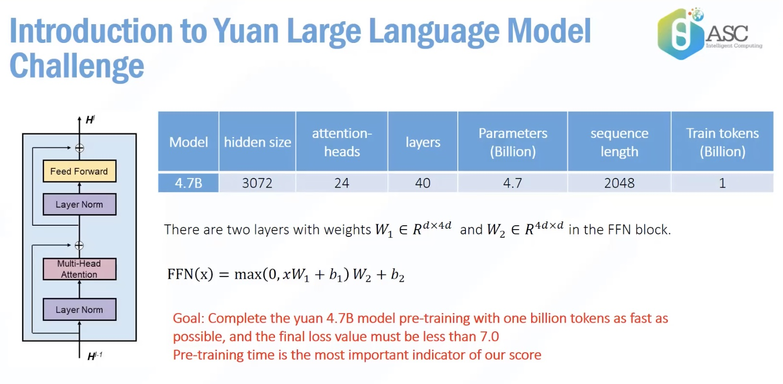
Yuan Large Language Model
Yuan is a Chinese GPT
Notes:
(Generative Pre-trained Transformer) model designed to
advance natural language understanding,
generation,
and translation tasks specifically for the
Chinese language.

Slide 16
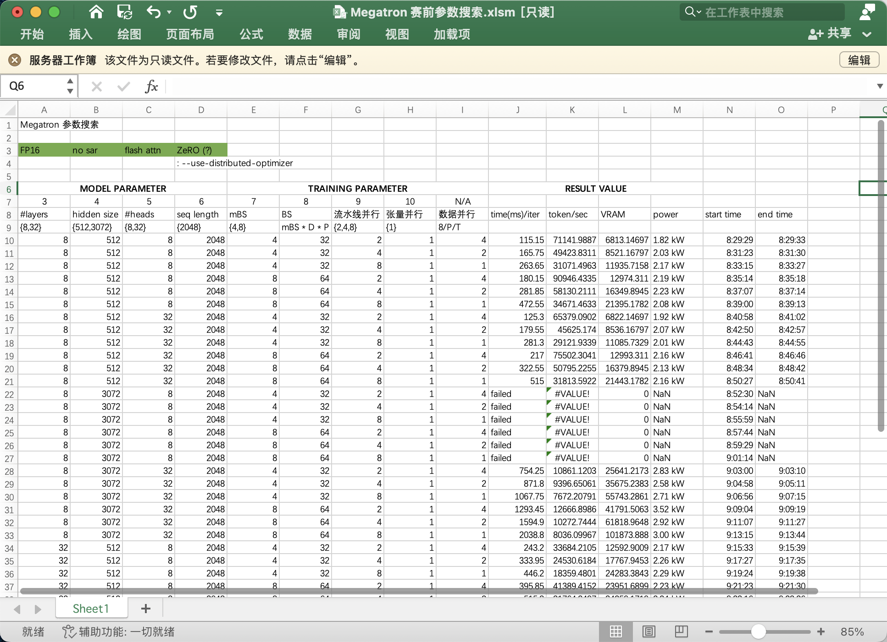
Yuan Large Language Model
Different Training Frameworks
DeepSpeed
Megatron
Different Hyperparameters
Parallel Size
Batchsize / Micro Batchsize

Slide 17
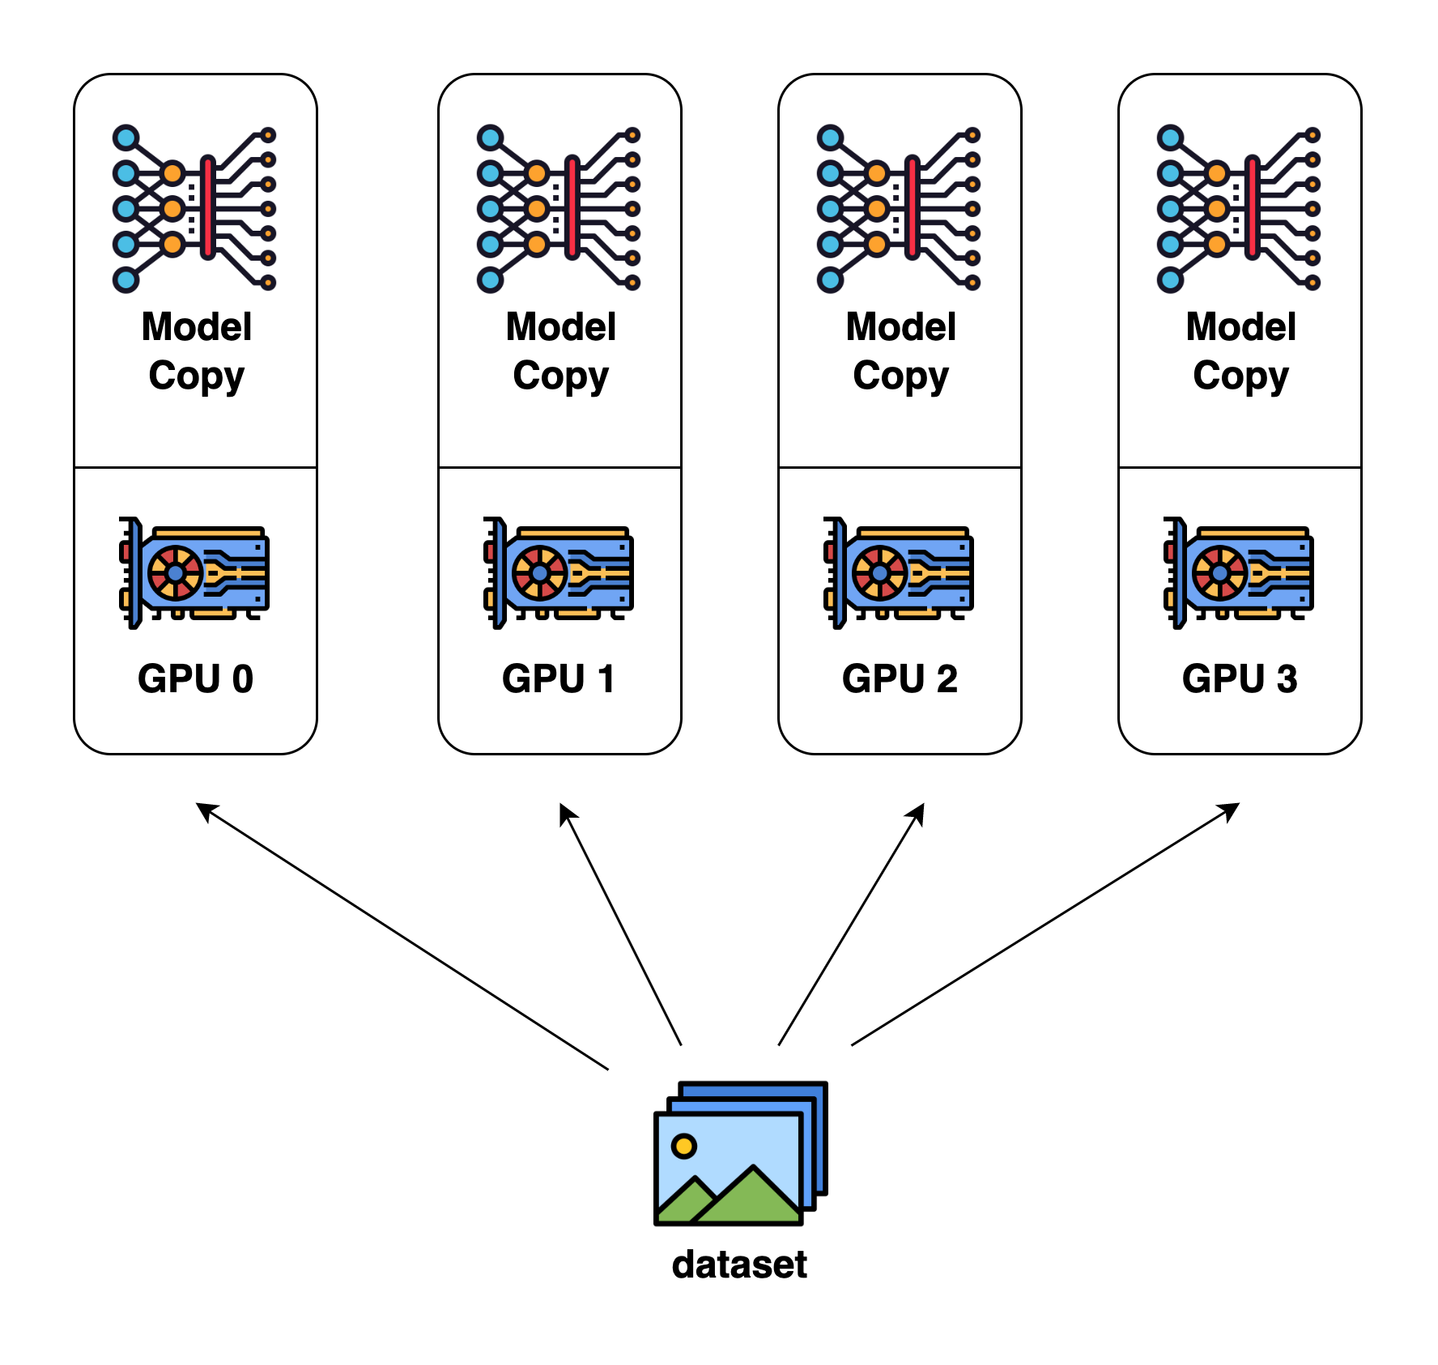
Yuan Large Language Model
Data Parallel
Model Parallel
Pipeline Parallel
Tensor Parallel
Data Parallel
Dividing input data into smaller mini-batches and processing them simultaneously on different GPUs
Pro: throughput scales almost linearly
Con: model parameters are duplicated on GPUs

Slide 18
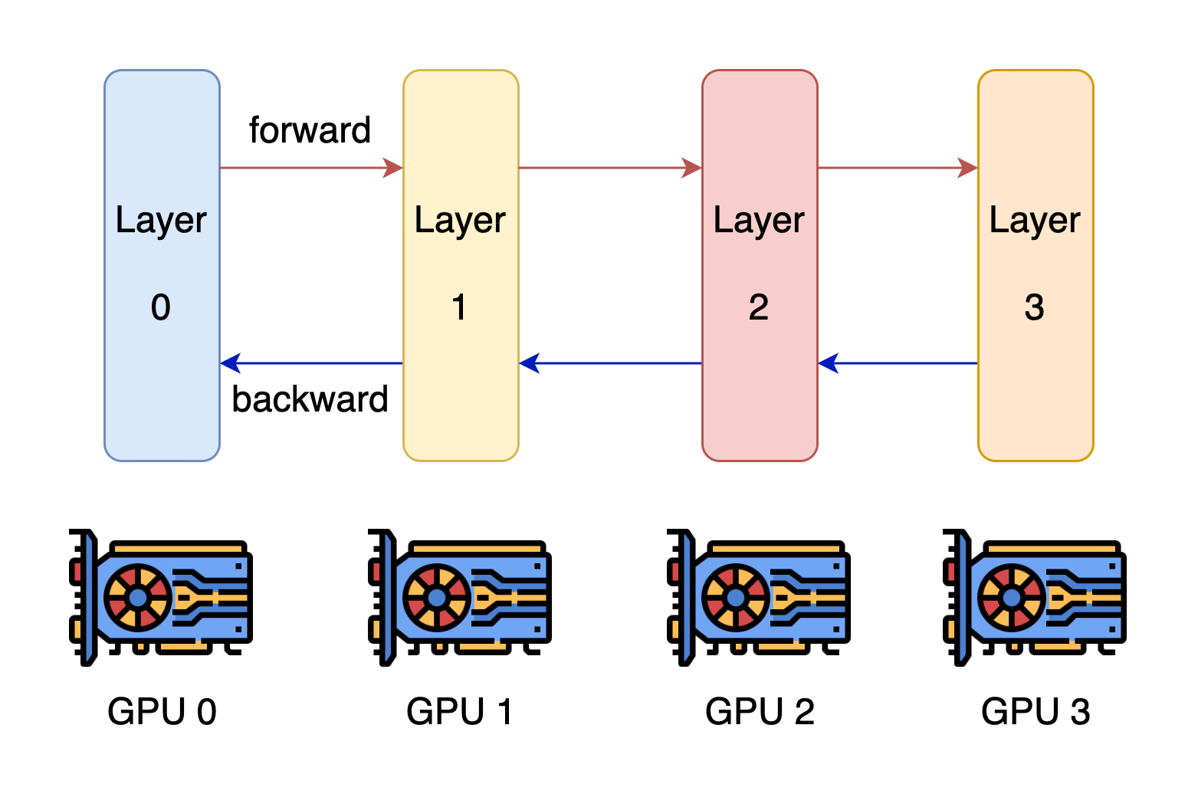
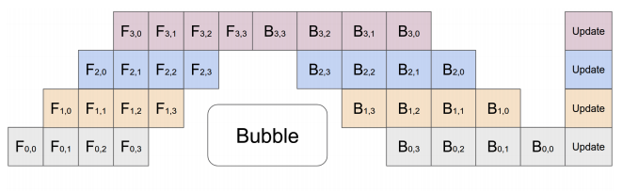
Yuan Large Language Model
Data Parallel
Model Parallel
Pipeline Parallel
Tensor Parallel
Pipeline Parallel
Dividing a model’s layers into smaller sub-models and processing them in stages across multiple GPUs
Pro: splits a large model onto multiple GPUs
Con: pipeline bubbles slow down execution

Slide 19
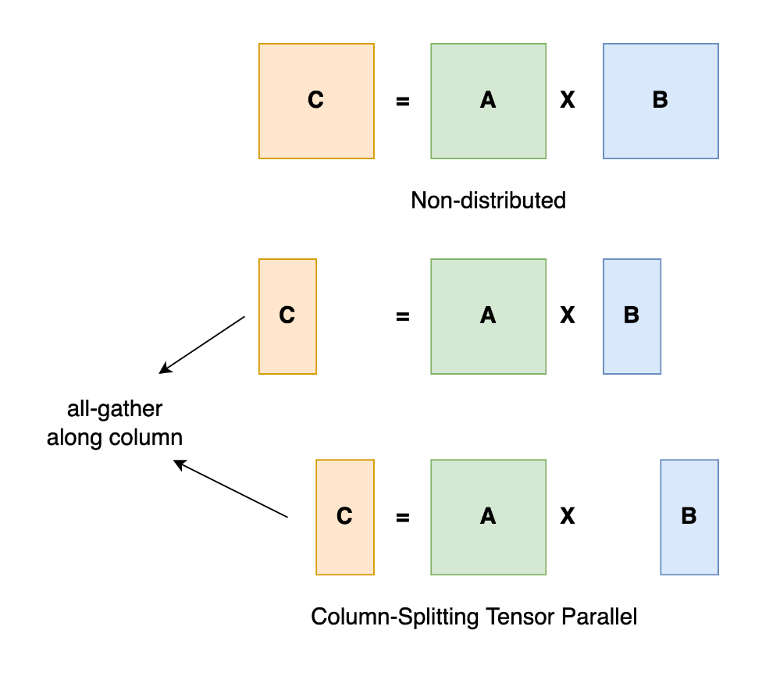
Yuan Large Language Model
Data Parallel
Model Parallel
Pipeline Parallel
Tensor Parallel
Tensor Parallel
Splitting a model's tensor operations across multiple GPUs
Pro: avoids pipeline bubbles
Con: incurs high communication volumes

Slide 20
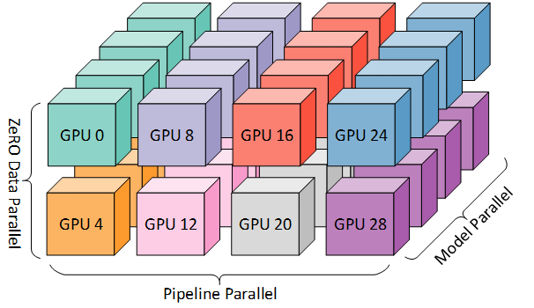
Yuan Large Language Model
Data Parallel
Model Parallel
Pipeline Parallel
Tensor Parallel

Slide 21
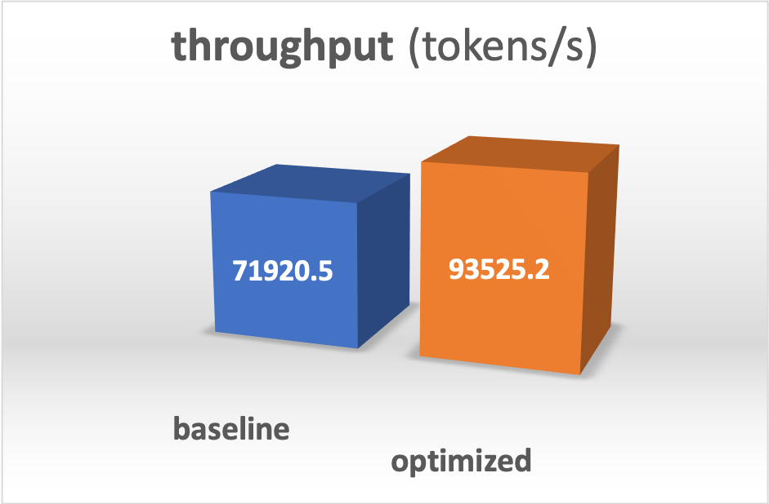
Yuan Large Language Model
Miscellaneous Techniques
ZeRO Redundancy Optimizer
Optimized kernel impl.
Gradient accumulation

Slide 22
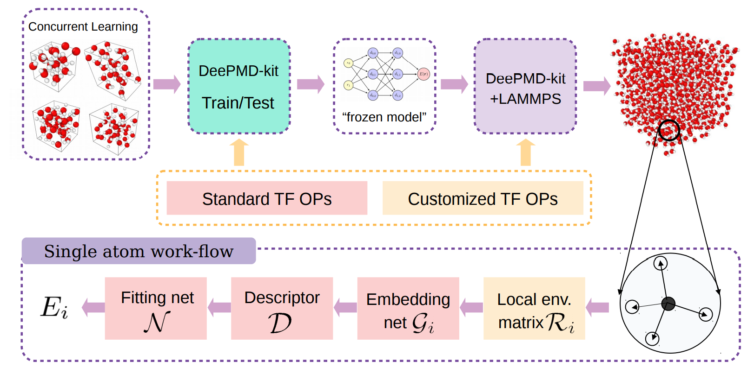
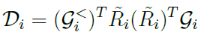
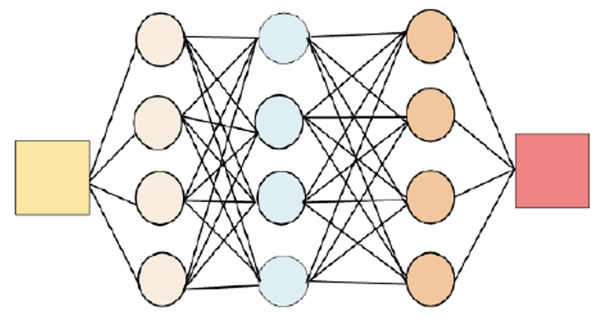
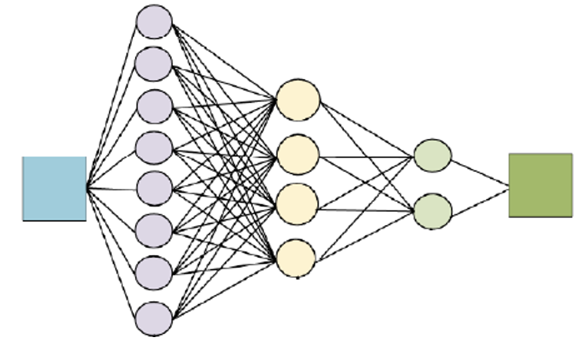
DeepMD
Background
Molecular dynamics simulations
Deep neural network
Input: atomic configurations
Output: their corresponding energies
Can be coupled with LAMMPS, GROMACS and so on
Model architecture
Descriptor: ensure three kinds of invariance.
Two-layer neural networks: embedding net and fitting net
Notes:
输入：原子坐标及种类，输出：系统势能（=单个原子势能之和）
Single atom workflow：
Descriptor：为了满足旋转、交换、平移不变性（利用矩阵乘法），截断
截断半径：只计算离一个原子较近的原子对它的影响
经过fitting net得到能量

Slide 23
DeepMD
Training Process
Data load
Data statistics
Build graph
Forward & Backward process
Env matrix
Embedding net
Fitting net
Parallel via TensorFlow
Optimize graph by Grappler
Reduce redundant reshapes
Kernel fusion via CUDA custom op
Kernel fusion
Mixed precision training
Multi-GPU data parallel training
Compressed training
Notes:
红色的部分是我们主要的优化
算子融合：某部分计算是Mg->Al->Cu，可以把矩阵concatenate起来做算子融合，但是只在1:1:1的算例上效果最好；2:1时负优化（填0/切成小块）
混合精度：代码里本来有bug，我们调好了

Slide 24
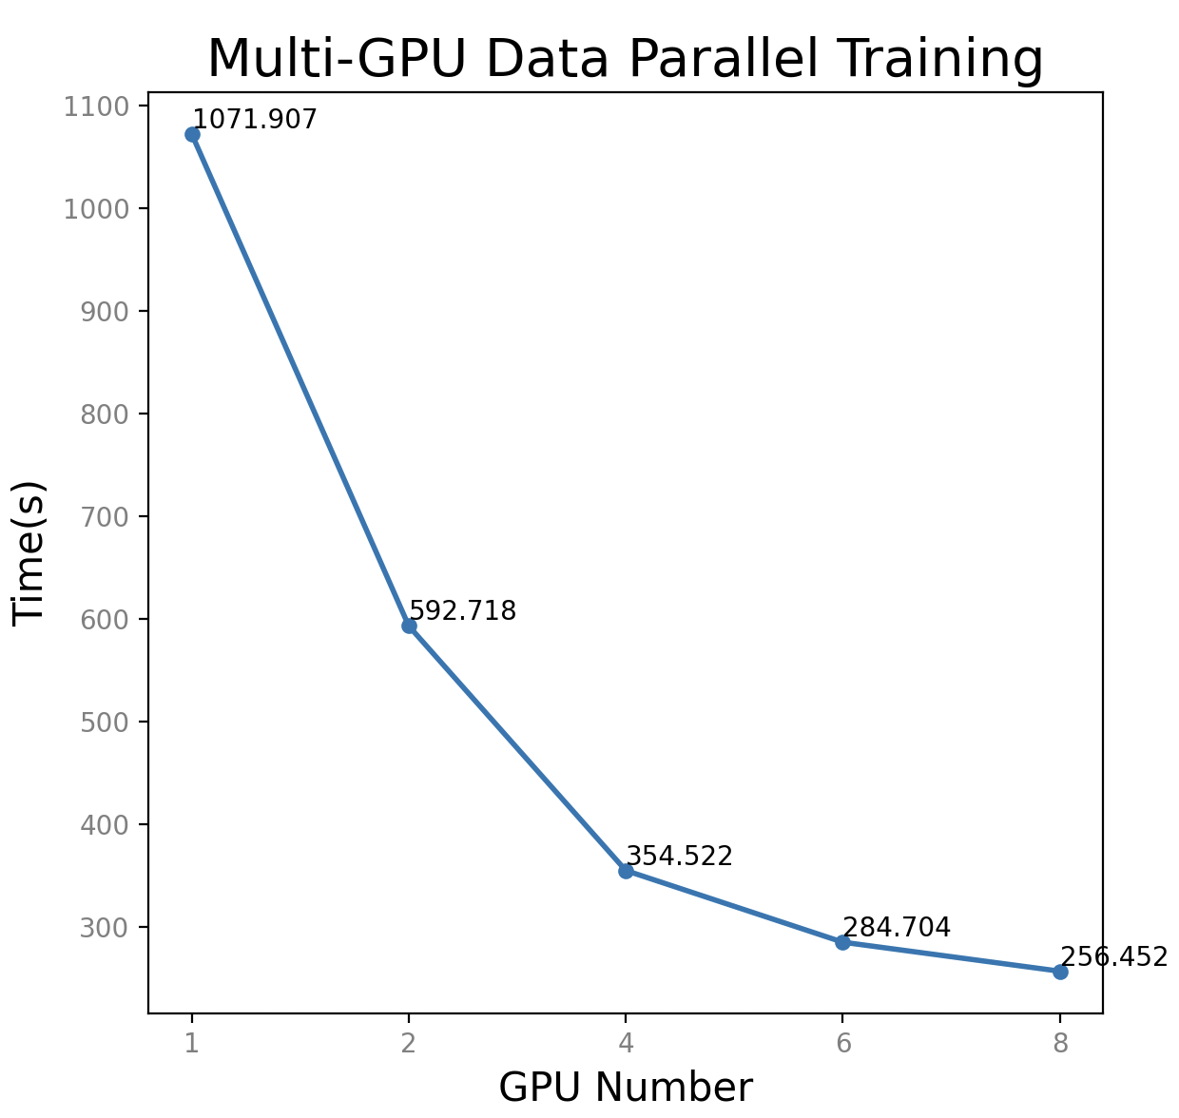
DeepMD – Data Parallel Training
Current Horovod approach
Each GPU run batchsize number of data per step, so the training time per step is even more than single GPU due to the communication overhead.
New approach
We spilt batchsize number of data into GPUs, the training time decreases since the computation cost reduced on each GPU, while ensuring the same accuracy as single GPU.
batchsize = 100,
time include first 100 batches
Data
batchsize
batchsize
batchsize
GPU1
GPU2
……
GPUn
1.8x
3.0x
Data
3.7x
4.1x
batchsize/n
batchsize/n
batchsize/n
GPU1
GPU2
……
GPUn

Slide 25
DeepMD – Loss-aware Compressed Training
Compressed Training
Using a fifth-order polynomial to fit the embedding network and fixing these parameters during training to optimize memory and computation.
Since the embedding network tends to converge early, we can train the complete network with a small amount of data and then fix it.
Automatically determine when to switch to compressed training
When loss is less than a certain number (i.e., 0.5) for over 100 steps consecutively, we can switch to compressed training.
Speed up the training procedure while maintain the accuracy.
Train the complete net one step
n
Loss < 0.5 for 100 steps consecutively
y
Scale the start and stop learning rate
Fix the embedding net and train the fitting net for the remaining steps.
Notes:
赛题一，让我们自动找冻结网络的时机。Loss是有意义且方便观察出来的量

Slide 26
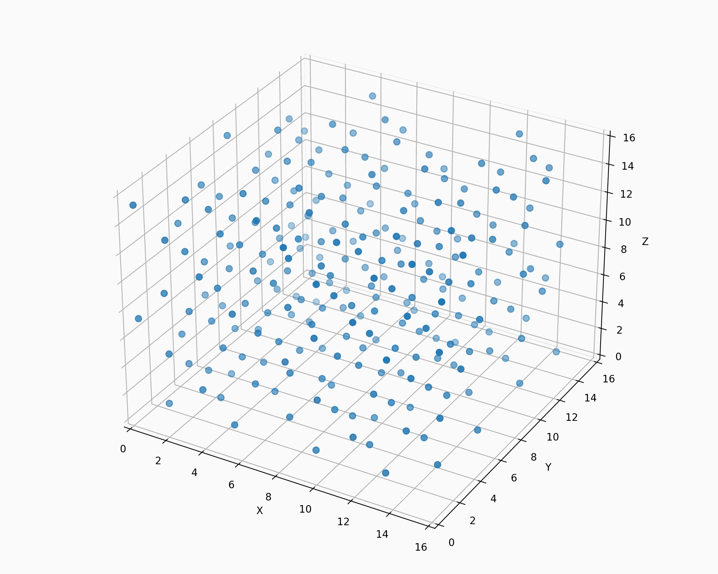
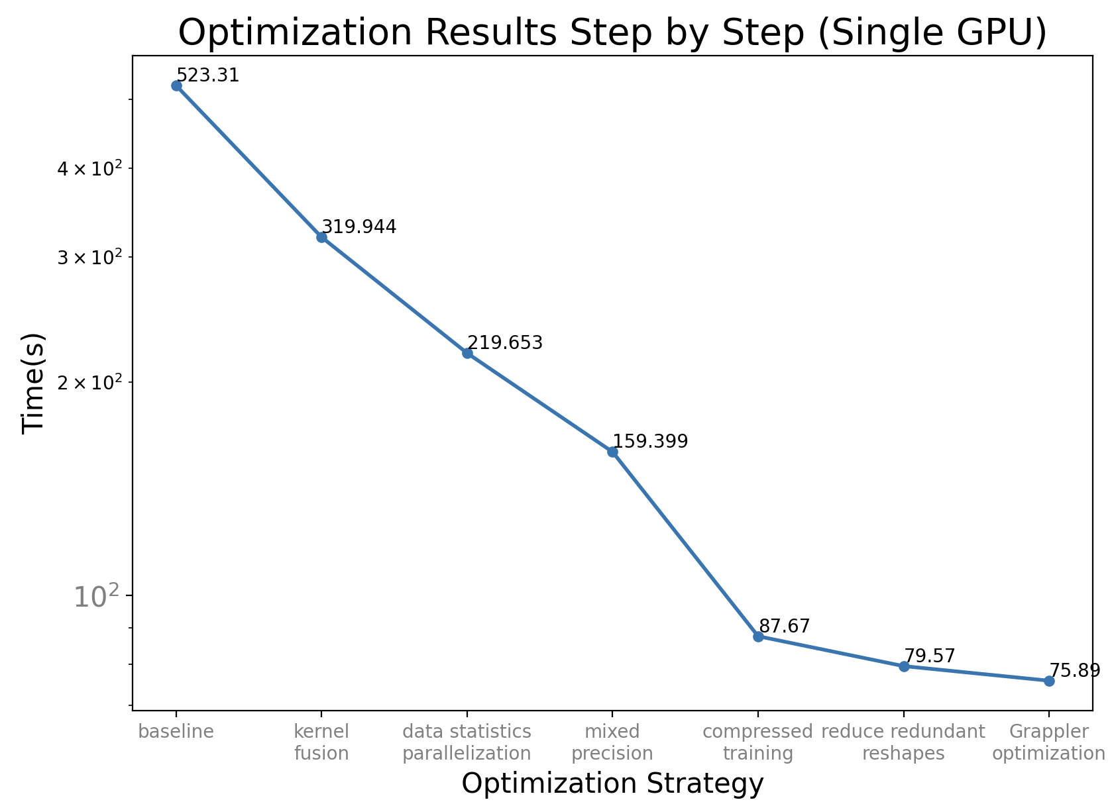
DeepMD
Results and visualization
Integrate DeePMD with ASE
256 Cu atoms with 500fs
1.6x
2.3x
3.3x
5.9x
6.5x
6.9x

Slide 27
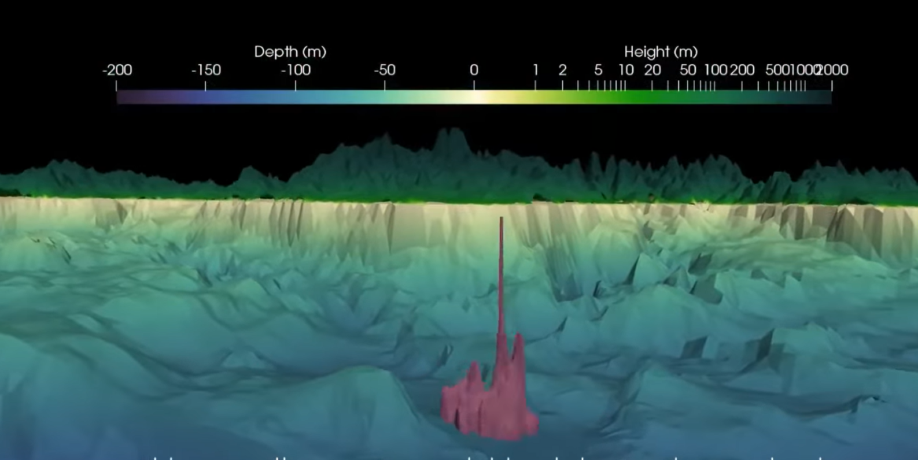
Mysterious Application
FVCOM overview
The Finite Volume Community Ocean Model is a prognostic, unstructured-grid, free-surface, 3-D primitive equation coastal ocean circulation model
Written in Fortran, run with mpirun

Slide 28
Mysterious Application
Compile with OneAPI build toolchain
First Attempt → Failed to compile
Make with “CC=mpiicc CXX=mpiicxx FC=mpiifort” → Failed to launch (input file “obc.dat” not correct)
Duplicate second line manually → Double free error
export I_MPI_FABRICS=shm → Segmentation Fault
Locate error code → Matis partition
Replace Matis lib → Too hard, give up
GNU build toolchain
First Attemplt → “redefined __log2”
Rename __log2 function of Metis → unrecognized compiling flag –xhost
Remove –xhost flag → undefined reference of netcdfxxx
Check NetCDF lib, compile it agained → Same error
Use Our own NetCDF → Same error
Use Docker image to build → Failed to launch (input file “bricg.dat” not correct)
Debugging
Found why input files are not correct → Program didn’t read the second line
Figure out why file is wrongly read → Backspace not working

Slide 29
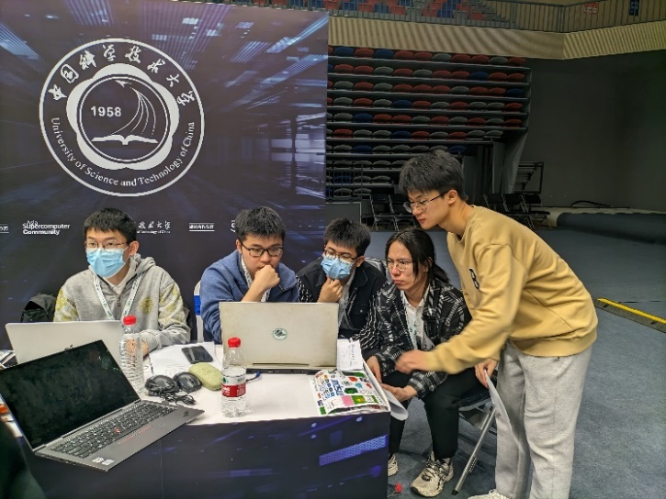
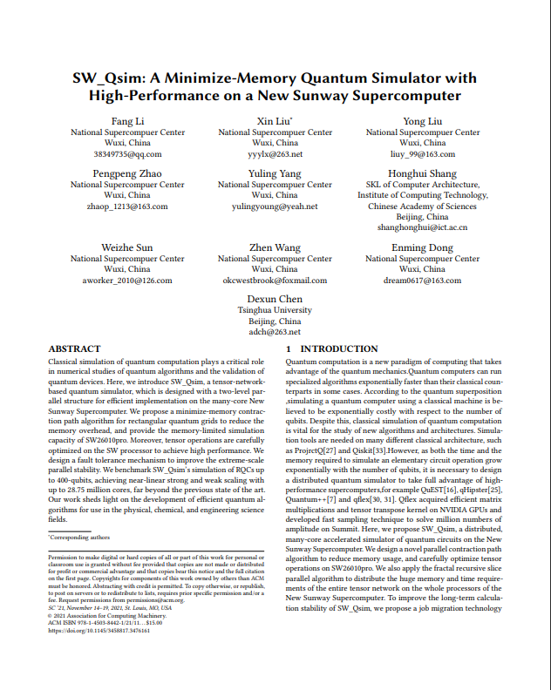
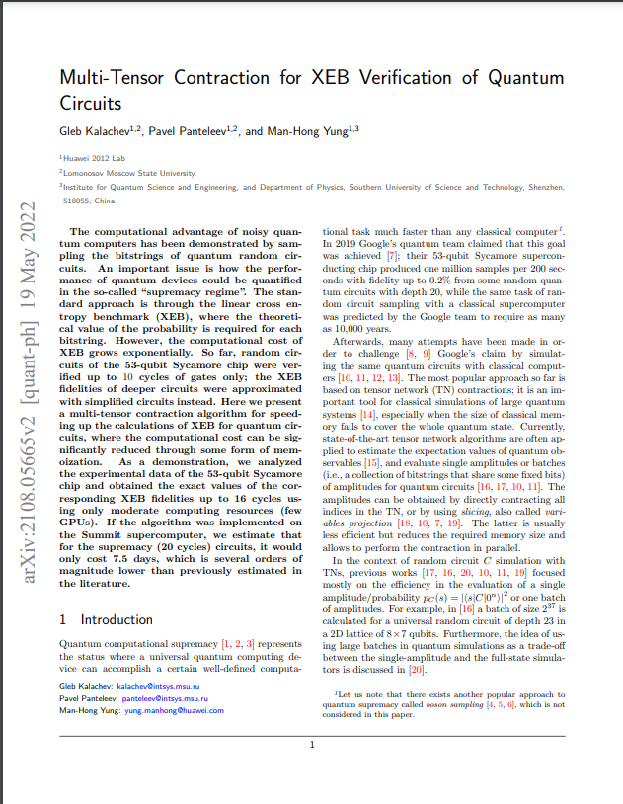
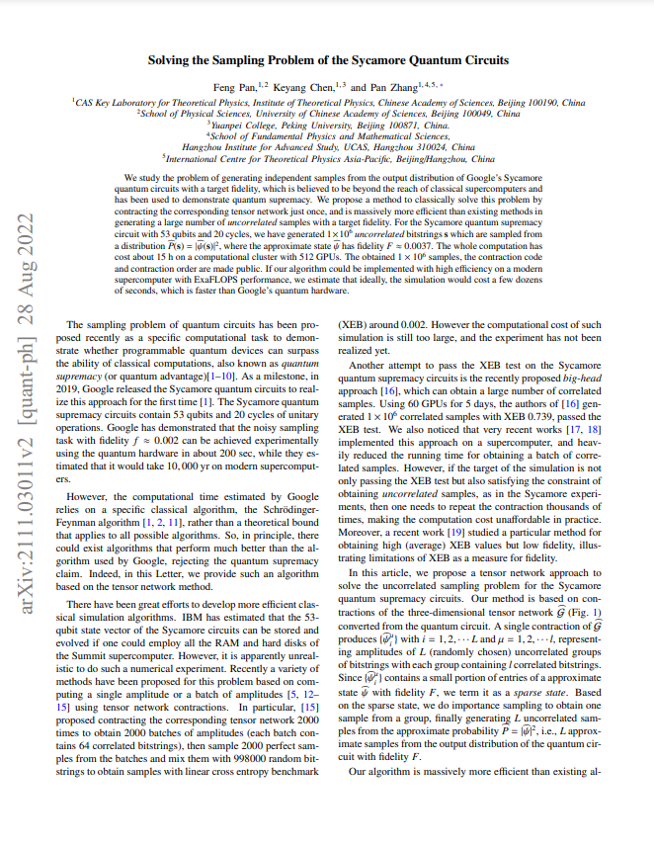
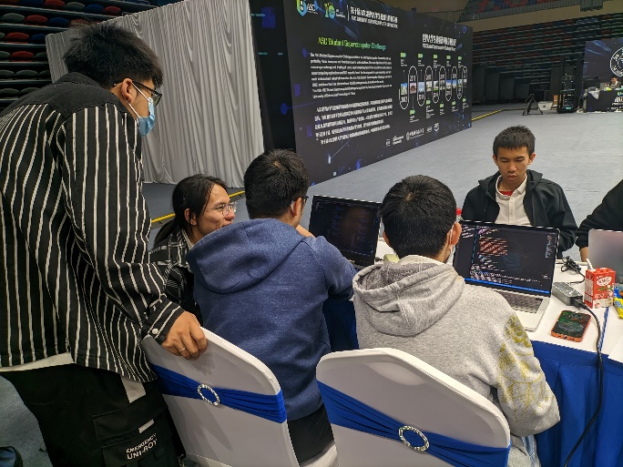
Group Competition
COLLABORATION
Random quantum circuit sampling demonstrates quantum computing superiority. Tensor network-based simulation accelerates the process, aiding quantum hardware design and verification.
EXPLORATION

Slide 30


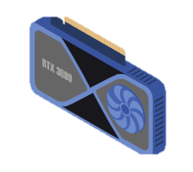
Group Competition
Firstly split the data
Dispatch it to different nodes and different graphics cards through openmpi
And obtain the final result by merging calculations
Each process only need to communicate in disk, so we can simply separate them into multi-GPU
data
data
…
data
PY
PY
PY
OpenMPI
DISK
TIME
XEB
FINAL TIME & XEB

Slide 31
Memorable Moments

Slide 32
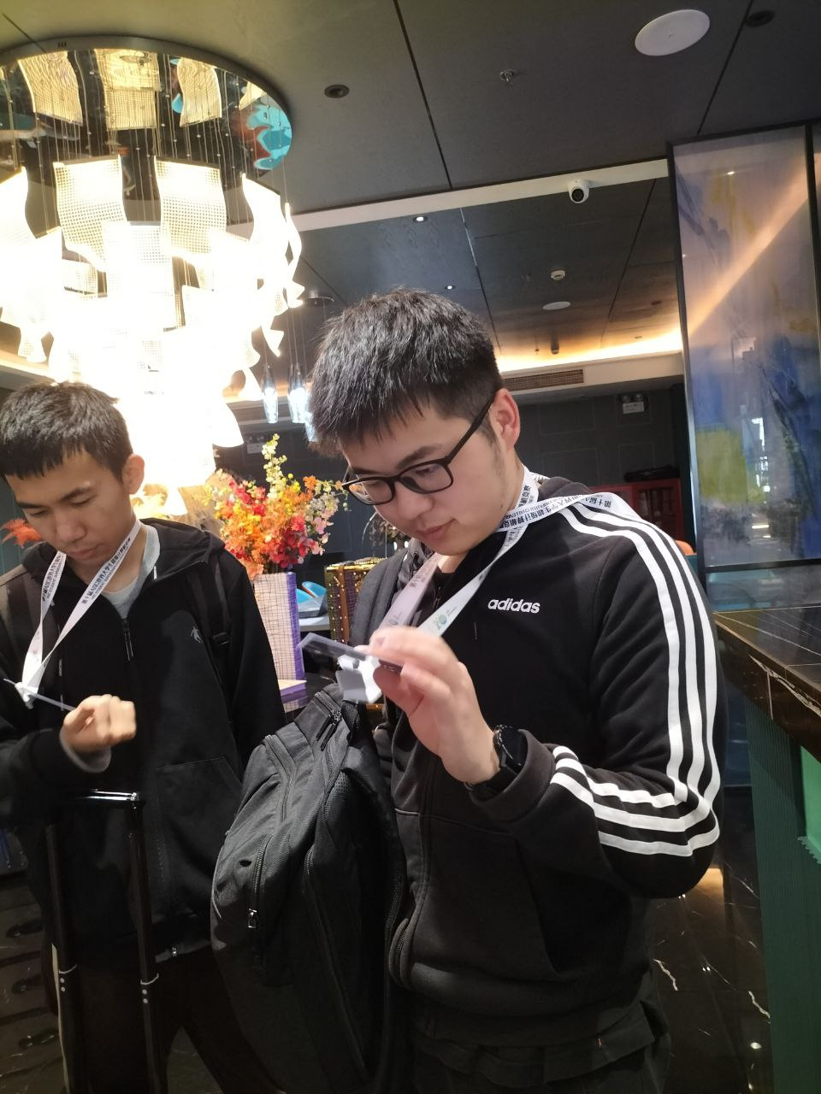
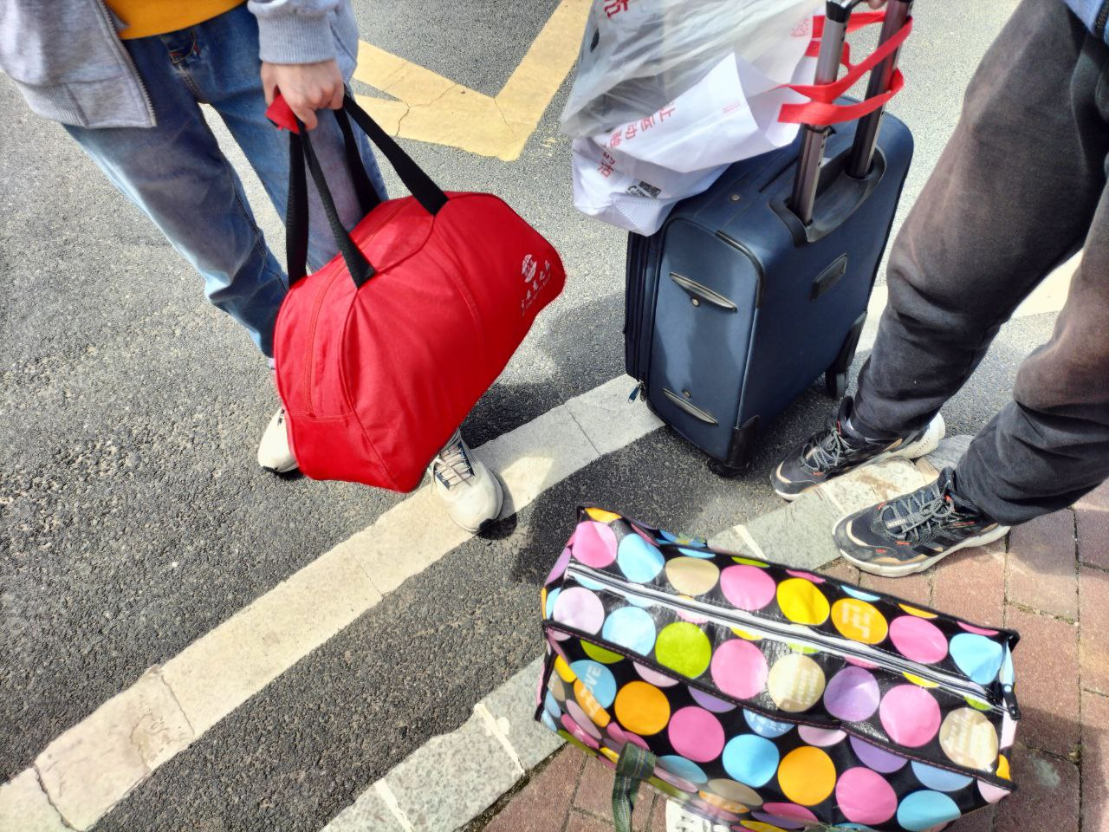
Packing and Preparing

Slide 33
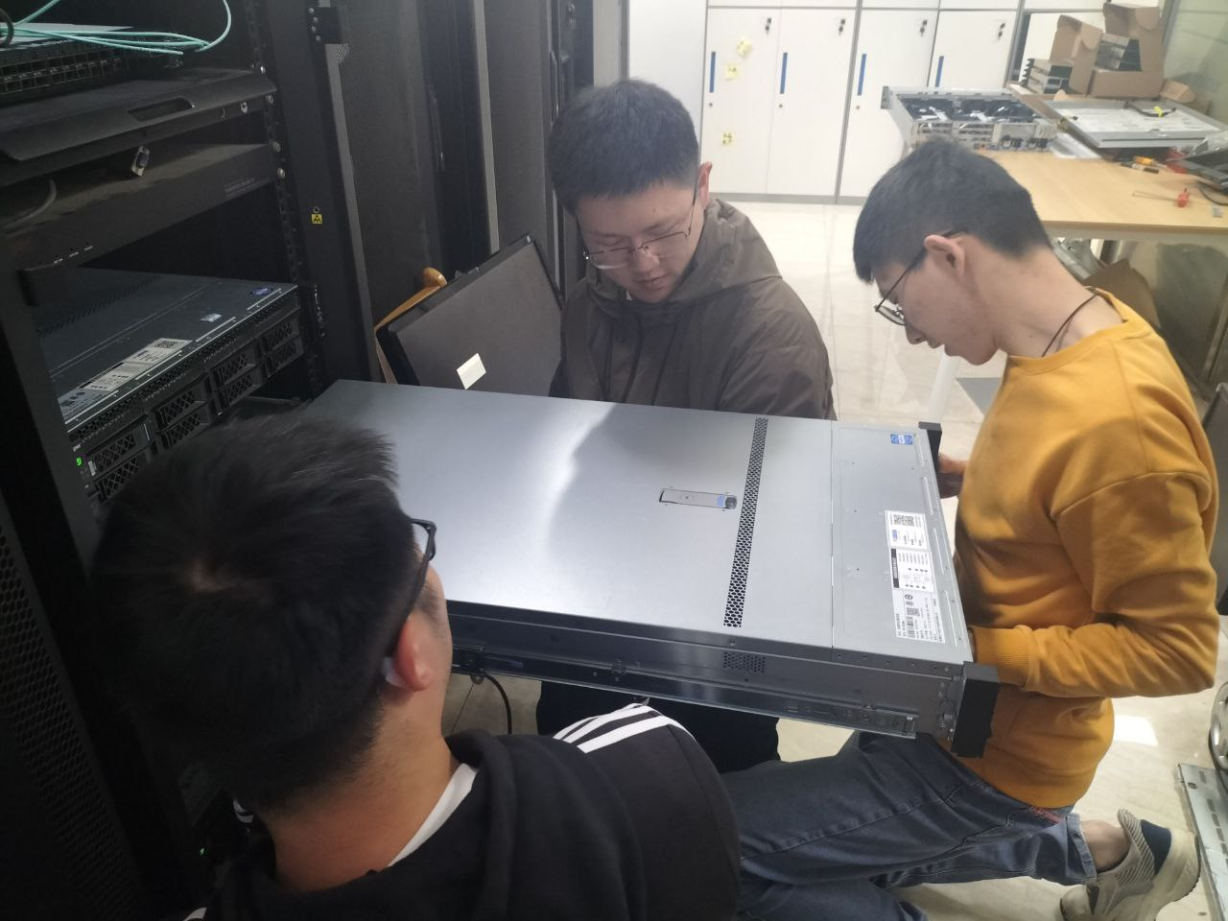
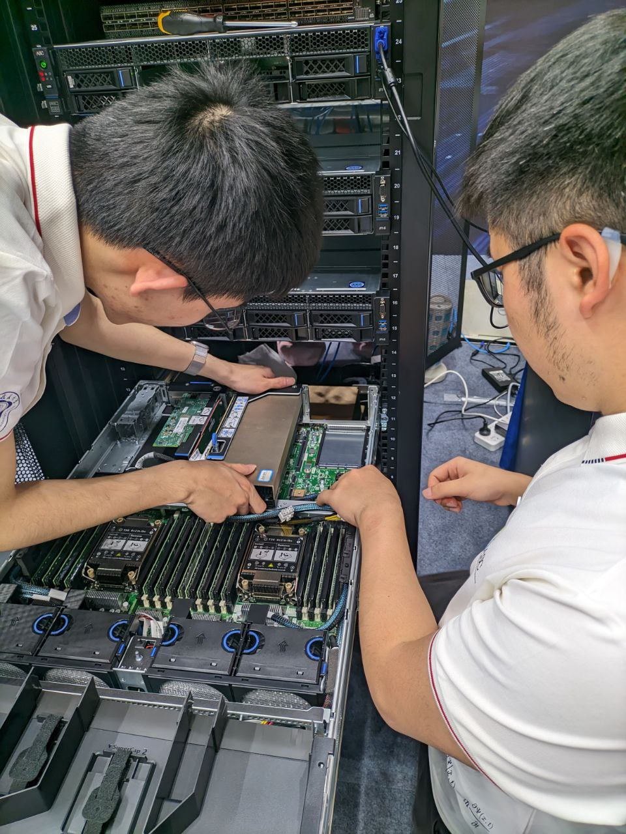
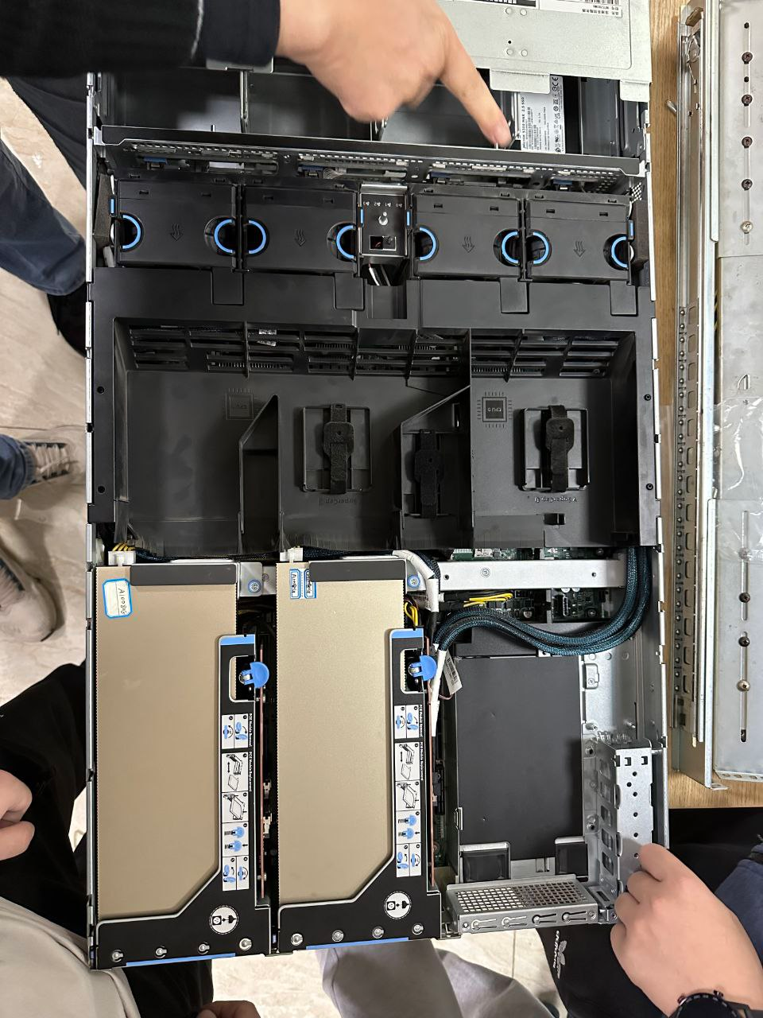
Hardware Assembly

Slide 34




Enjoying Delicious Breaks

Slide 35



Daily Team Interactions

Slide 36


The Grand Showdown

Slide 37

The Grand Showdown

Slide 38

The Grand Showdown

Slide 39
Thank you for listening!

